Slide 1
Deep Learning with Apache MXNet
8th March 2019

Slide 2
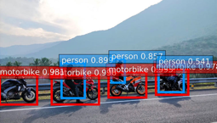
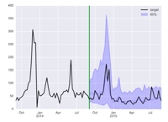

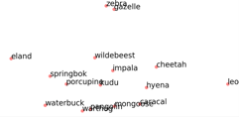

Why Deep Learning?
Well suited for a variety of artificial intelligence use-cases
Computer Vision (CV)
Forecasting
Recommendation Engine
Natural Language Processing (NLP)
Automatic Speech Recognition (ASR)
Notes:
When you look at tech publications and when you experiment yourself with actual data, you figure out that deep learning is well suited for a variety of tasks, in particular tasks that involve large datasets of high dimensionality data with abstract features.
If you are working on such use cases today – computer vision, recommender systems, speech and language processing, multi-dimensional timeseries, you should consider trying deep learning approaches

Slide 3
MXNet Overview

Slide 4






Why MXNet
Deep Learning Framework
Optimized
libraries
8 frontend
languages
Scalable
Debuggable
Flexible
Portable
Notes:
Very efficient library. It works equally well in very large environments: cloud based environment, where it nearly scales linearly to hundreds of GPUs, but it can also run on edge devices where we have resource constraints. We can develop highly efficient models for mobile and IoT devices. For instance Resnet 1024 layer network is roughly 4GB and you can run MXNet on a Raspberry Pi.
Conservative memory usage and very fast.
It provides a hybrid programming model which allows us to have fast efficient models that can easy be debugged.
.

Slide 5
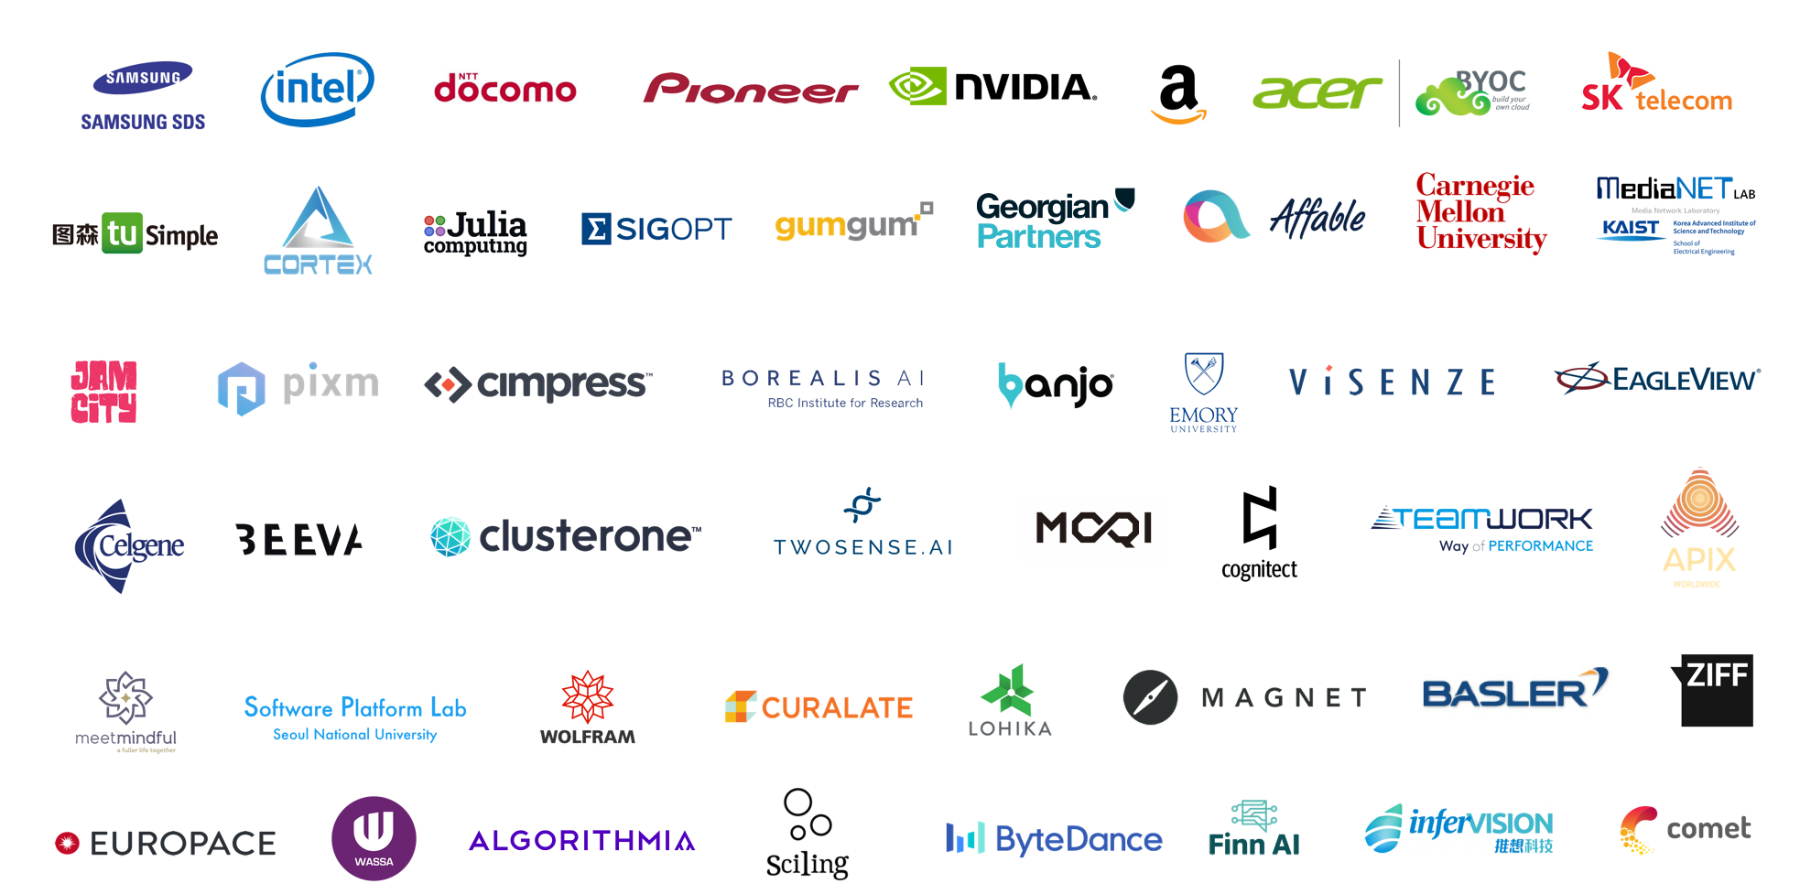
MXNet Customer Momentum
Notes:
Very efficient library. It works equally well in very large environments: cloud based environment, where it nearly scales linearly to hundreds of GPUs, but it can also run on edge devices where we have resource constraints. We can develop highly efficient models for mobile and IoT devices. For instance Resnet 1024 layer network is roughly 4GB and you can run MXNet on a Raspberry Pi.
Conservative memory usage and very fast.
It provides a hybrid programming model which allows us to have fast efficient models that can easy be debugged.
.

Slide 6
MXNet Quick History

Slide 7
MXNet originated from DMLC
& many more…
Distributed Machine Learning Community
XGBoost
MinPy
MXNet
Notes:
DMLC is the Distributed machine Learning common Initiative. Machine learning and data-driven approaches are becoming very important in many areas. It is increasing important to make scalable machine learning solutions. So at the University of Washington they created this joint effort, where multiple univeristies like Stanford and New York University would collaborate on Projects together to build scalable machine learning tools. Some of the famous ones are MXNet, MinPy and XGBoost. MinPy is a Numpy interface that allows to perform computations on either CPU or GPU and it is used in MXNet as thew Ndarray API.

Slide 8
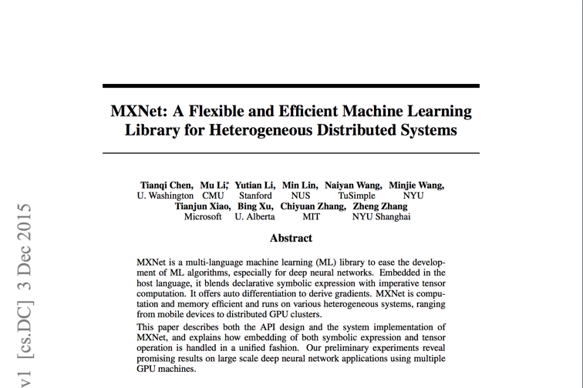
Original Paper in 2015
https://arxiv.org/pdf/1512.01274.pdf
Notes:
Opensource project that started 2015
University driven project MXNET. Developed with focus on scalability, efficient parallel processing and flexibility with support of different host languages.

Slide 9
Major Events
Amazon’s deep-learning framework of choice
since November 2016.
Accepted into
Apache Incubator
in January 2017.
Notes:
The reason why AWS likes mxnet is because it comes with a lot of different frontend languages.
It is good for our customers because we have millions of customers and not everyone uses Python or C++.
Accepted into the Apache incubator
Driven by the Apache process
No single entity, no single organization can influence the features of MXNet

Slide 10
MXNet Ecosystem

Slide 11
Multi-language Support
While keeping high performance from efficient backend
R
Perl
Julia
Clojure
Python
Java
Scala
C++
Frontend
Backend
C++

Slide 12
Ecosystem
TVM
ONNX
Model Zoo
TensorRT
GluonCV
Model Server
GluonNLP
MXBoard
Keras
Notes:
MXNet as Keras backend. You can just use your Keras models and run them with MXNet backend and profit from performance speedups.
GluonCV: Deep Learning Toolkit for Computer Vision. Training scripts that reproduce state of the art results. Large set of pretrained models. Can use it for transfer learning.
GluonNLP: Deep Learning Toolkit for NLP. Pretrained models such as embeddings. These toolkits allow that you dont have to start from scratch.
TensoRT:
Nvidia platform that comes with deep learning inference optimizer and runtime that delivers low latency and high-throughput
High-performance deep learning inference.
Layer and Tensor fusion
Precision calibration: int8 fp16 optizimiations
TVM: Model compiler. You tell It what hardware you have and it will compile your model to run on the most optimal way on this specific hardware. Hardware such as Raspberry Pi etc. → hardware portabaility.
ONNX: Open Neural Network Exchange Train a model in Pytorch and execute inference in MXNet. A format that was introduced by Facebook and Microsoft. This format makes life of machine learning researchers much easier. They are not forced to implement their entire pipeline in one framework of choice. But can for instance choose their most favorite framework for researching new models and a use a different framework for productions system when speed matters.

Slide 13



Ecosystem - Imperative API
Debuggable
Flexible
Scalable
Notes:
The nodes of the graph are executed as the Python code executes.
Hybrid:
You don’t need to decide for one or the other. You can just implement imperative and hybridize the network afterwards
Debuggable: Gluon API every execution comes back to Python and you can plug in a debugger to check shape of tensors, values of the gradients, heatmaps of gradient updates.
Flexible: combines imperative and symbolic

Slide 14
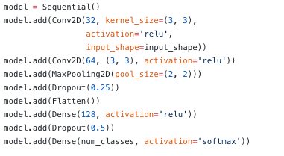
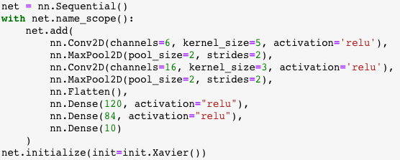
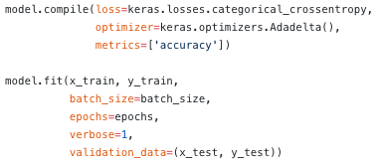
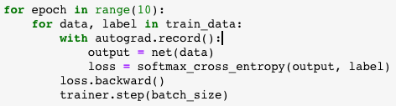
Imperative versus Symbolic
e.g. Inception Stage
Symbolic is “define, compile, run”
Imperative is “define-by-run”
Notes:
A deep Learning model is a computational graph where you define a series of computations and operations and pass data through it.
2 approaches to build computational graph:
Symbolic: Define variables, computations. One this is defined, you would compile the model into an IR that defines the links between all the tensors in every step of the operation.
Engine takes care of building the graph and optimizing it. For instance the engine can check how to reuse memory, which operators to fuse. It can do a proper graph optimiztions. Difficult to debug because of lazy evaluation: until we execute the graph we don’t know what will happen. It build first the graph, and then binds the data.
E.g. loss is not converging, tensor shape mismatch -> very little visibility of what is happening, blindly debug the code, no insight because lazy evaluation
That’s how Caffee, Tensorflow worked. Keras example. Compile->, fit
Imperative programming: straightforward and flexible. It is hard to optimize.
Mixed programming combines advantages of both worlds.
Take advantage of language native features such as loops, conditions and debugger. Execution is driven by the host language. Definition step is the same like the symbolic one.
You don’t give a bunch of data and then call fit. You go through every epoch and each epoch we pass batches of data, get the loss, do the backward propagation of the gradients and update parameters with respect to the loss.
Fast to prototype. You don’t have to develop the full network and once call fit figure out why it crashed.

Slide 15
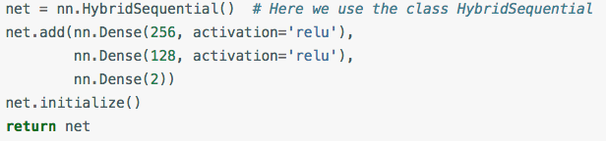
Hybrid programming
Develop and debug using pure imperative programming
Convert program into symbolic programming to achieve best computing performance using graph optimizations techniques
net.hybridize()
30% faster
Notes:
When you are ready, you debugged the model, it is training well, you can start recording: during first batch it is recorded what is happening, each operation is recorded in a symbolic form. Second batch is using the cached operators.

Slide 16
Asynchronous Engine
Sync
Async
Operations appear to return immediately, but just pushed to engine queue on backend.
Allows for much greater parallelism.
Serial or parallel? “The execution of any two functions when one of them modifies at least one common variable is serialized in their push order.”
Must wait_to_read() or similar to retrieve value and this blocks.
backend
frontend
wait_to_read()
Notes:
How does MXNet achieve high scalability: engine is running asynchronously. You just call operators which gets pushed to a multithreaded engine. Engine will perform optimizations.
The runtime dependency engine analyzes the dependencies in computation processes and parallelizes the computations that are not dependent. On top of runtime dependency engine, MXNet has a middle layer for graph and memory optimization
users can perform any operations they define and the engine should be able to also handle custom operations
It should not be restricted in what type of objects it can schedule.
We should be able to schedule dependencies on GPU and CPU memory.
We should be able to track dependencies on the random number generator, etc.
The engine should not allocate resources. It should only track dependencies. Users can allocate their own memory, PRNG, etc.

Slide 17
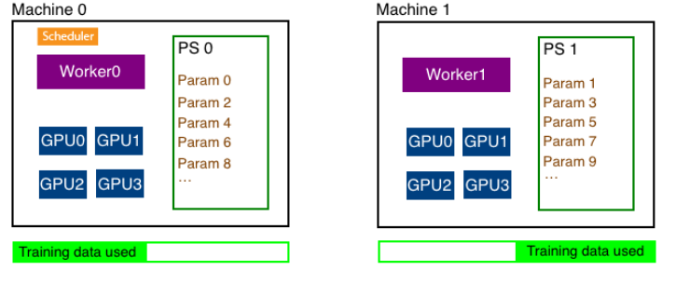
Distributed Training
New!
Notes:
Multihost distributed training involves working with three different types of processes - worker, parameter server and scheduler.
Parameter Server:
Parameters need to be shared with all hosts. Parameters are split across multiple host and there is a a parameter server in each host that stores a subset of parameters. At the end of every iteration, each host communicates with every other host to update all parameters of the model.
Worker:
Each host has a worker process which in each iteration fetches a batch of data, runs forward and backward pass on all GPUs in the host, computes the parameter updates and sends those updates to the parameter servers in each host. Since we have multiple workers to train the model, each worker only needs to process 1/N part of the training data where N is the number of workers.
Scheduler:
Scheduler is responsible for scheduling the workers and parameter servers. There is only one scheduler in the entire cluster.
KV-Store:
Like mentioned above, in distributed training, parameters are split into N parts and distributed across N hosts. This is done automatically by the distributed key-value store. User only needs to create the distributed kv store and ask the Trainer to use the created store.

Slide 18
Deep Learning acceleration
CUDA & CuDNN
TensorRT
MKL, MKLML & MKLDNN
pip install mxnet-cu92
pip install mxnet-tensorrt-cu92
e.g. pip install mxnet-mkl
TVM

Slide 19
Community

Slide 20
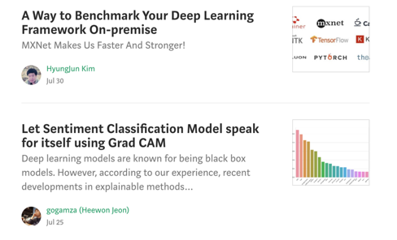
Keeping Up to Date
Medium: https://medium.com/apache-mxnet

Slide 21
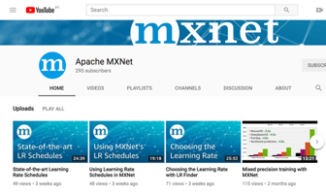

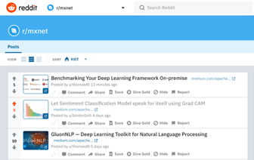
Keeping Up to Date: Social
YouTube: /apachemxnet
Twitter: @apachemxnet
Reddit: r/mxnet
Notes:
https://www.reddit.com/r/mxnet/

Slide 22
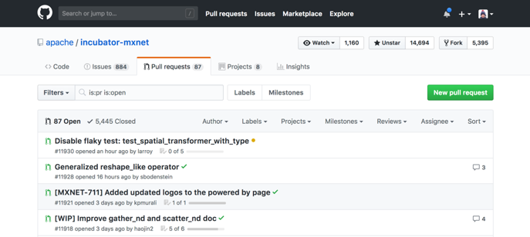
Community
GitHub: https://github.com/apache/incubator-mxnet

Slide 23
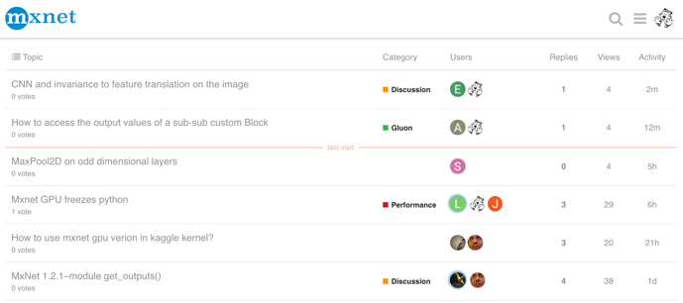
Community
Discuss Forum: https://discuss.mxnet.io/

Slide 24
Go build!
Gluon https://gluon.mxnet.io/
GluonCV https://gluon-cv.mxnet.io/
GluonNLP https://gluon-nlp.mxnet.io/
Deep learning book http://www.d2l.ai/

